Slide 1

Chapter 9
Successful Aging

Slide 2

Sister Jean

Slide 3


Slide 4
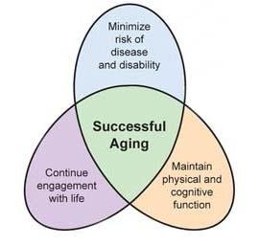
Successful Aging
Successful achievement of the balance between gains and losses during aging
Adding life to years in addition to adding years to life

Slide 5
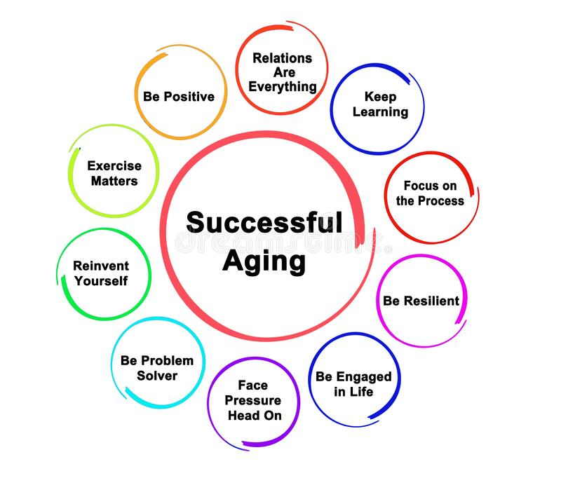

Slide 6
Why Does Aging Matter?
2021 Data
W 79.1
M 73.2
2020 Data
W 79.9
M 74.2
Change mostly due to covid, drug overdoses
Knowing what predicts successful aging might help us prepare now for later years.
The world is getting older.
Longer lifespans
Lower birth rate
Negative stereotypes about aging can interfere with interactions with older adults
Personally
Professionally
Positive:
Kind Warm
Wise

Slide 7
Myth vs Reality
Negative Stereotype | Expectation 18-64yo | Experience 65+
Memory Loss | 57% | 25%
Unable to drive | 45% | 14%
Serious illness | 42% | 21%
Sexually inactive | 34% | 21%
Depression or sadness | 29% | 20%
Not feeling needed | 29% | 9%
Loneliness | 29% | 17%
Trouble paying bills | 24% | 16%
https://www.thegoodcaregroup.com/news/challenging-negative-stereotypes-about-ageing/

Slide 8
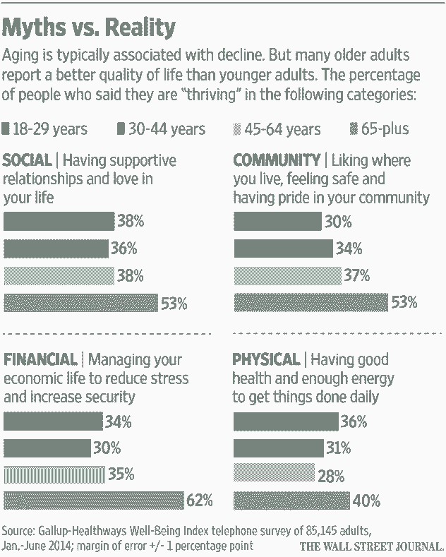

Slide 9

Some Changes with Age
Some mental functions show a decline
  Reaction times, ability to multitask, remember names
Some functions show improvement with age
  Complex reasoning skills, empathy, inductive reasoning, verbal memory, making financial decisions, ability to see connections/grasp big picture
Middle-aged brain may be less quick, but more shrewd

Slide 10
People with negative perceptions of aging have…
Higher rates of cardiac disease.
A median life expectancy that’s 7.5 years shorter.
Less chance of recovering from severe disability.
Poorer memory and cognition.
Lower quality diet and exercise regimes.
Less inclination to take medication as instructed.
Shakier handwriting.

Slide 11
Rowe & Kahn Successful Again
Distinguished 3 groups
  Older adults with pathology or disease states
  Normal older adults
  Successful agers
Normal aging associated with modest declines in physical and cognitive functioning (not pathological), and even though modest, do put at risk of problematic outcomes in physical, psychological, economic, and interpersonal difficulties

Slide 12
Rowe & Kahn Criteria
Basis for MacArthur Studies of Successful Aging
Typically modified to “minimal decrements” (as opposed to “no decrements”)
Successful Aging:
Low Disease Risk
High Physical and Cognitive Functioning
Active Engagement in Life, especially with interpersonal relationships and productive activities

Slide 13
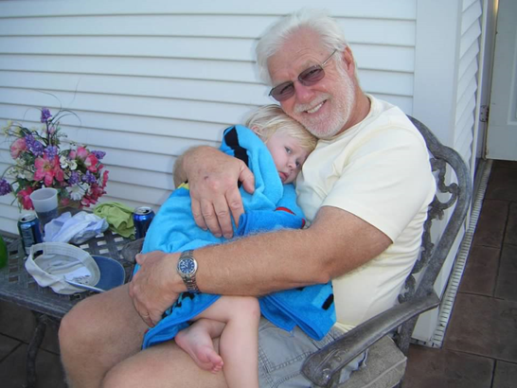
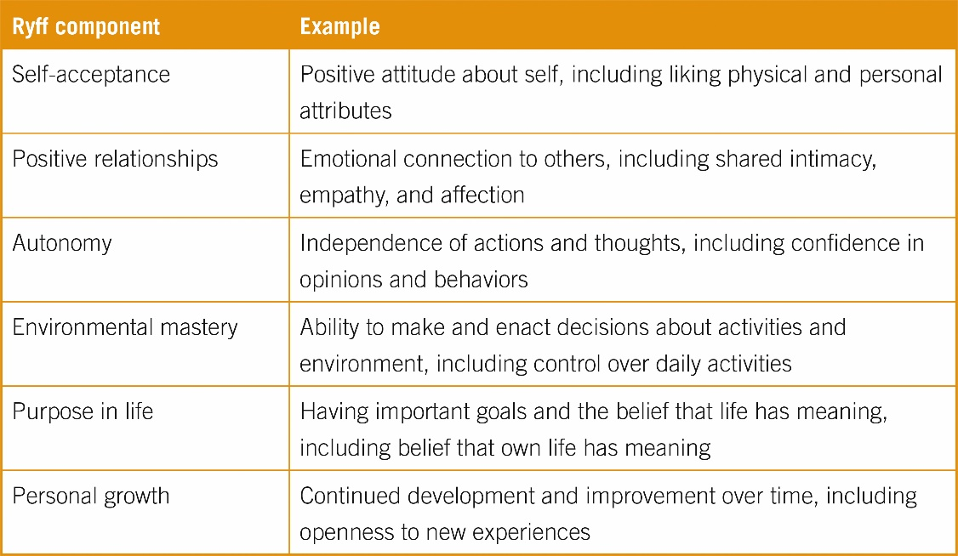
Ryff’s Model of
Successful Aging
Self-acceptance
Positive relationships with others
Autonomy
Control over one’s environment
Purpose in life
Personal growth
Differs: does not require physically healthy

Slide 14

Correlates of Successful Aging
Successful ager associated with better overall well-being
  Happiness
  Depression
  Relationships
  Energy
  Enthusiasm
  Optimism
  Perceived control

Slide 15

Young at Heart
https://www.youtube.com/watch?v=CjnfoFg7i7g

Slide 16
Some Foundational Studies of Successful Aging
The Macarthur Study
Introduced successful aging as a concept
Interdisciplinary team
The Harvard Study of Adult Development
Following cohorts of White men for nearly 80 years
Multimodal dataset (questionnaires every 2 yrs, physical health info every 5 yrs)
The Alameda County Study
Demographically diverse
Longitudinal starting with participants at age 65

Slide 17
MacArthur Study on Aging
Aging is not primarily determined by genetics — lifestyle matters more.
  30% of how we age is attributable to genetics
  70% shaped by behavioral choices, social connections, and environment
3 Components of Successful Aging
  Low risk of disease and disability
  High mental and physical functioning
  Active engagement with life (cognitively, socially, physically)
Social support and meaningful relationships protect against decline

Slide 18
Alameda 7
Health behaviors most strongly related to mortality
  Sleep 7-8 hrs/night
  Eat breakfast
  Eat regular meals and not eating between meals
  Maintain healthy weight
  Exercise regularly
  Limit alcohol consumption
  No smoking

Slide 19
Harvard Study
The Harvard Study of Adult Development identified predictors before age 50 that predicted “healthy and happy” aging after age 65
  **Strong supportive relationships**
  Perseverance (for Harvard grads)
  Absence of cigarette use and alcohol use disorder
  Warm marriage
  Absence of depressive disorder
  Good physical health

Slide 20
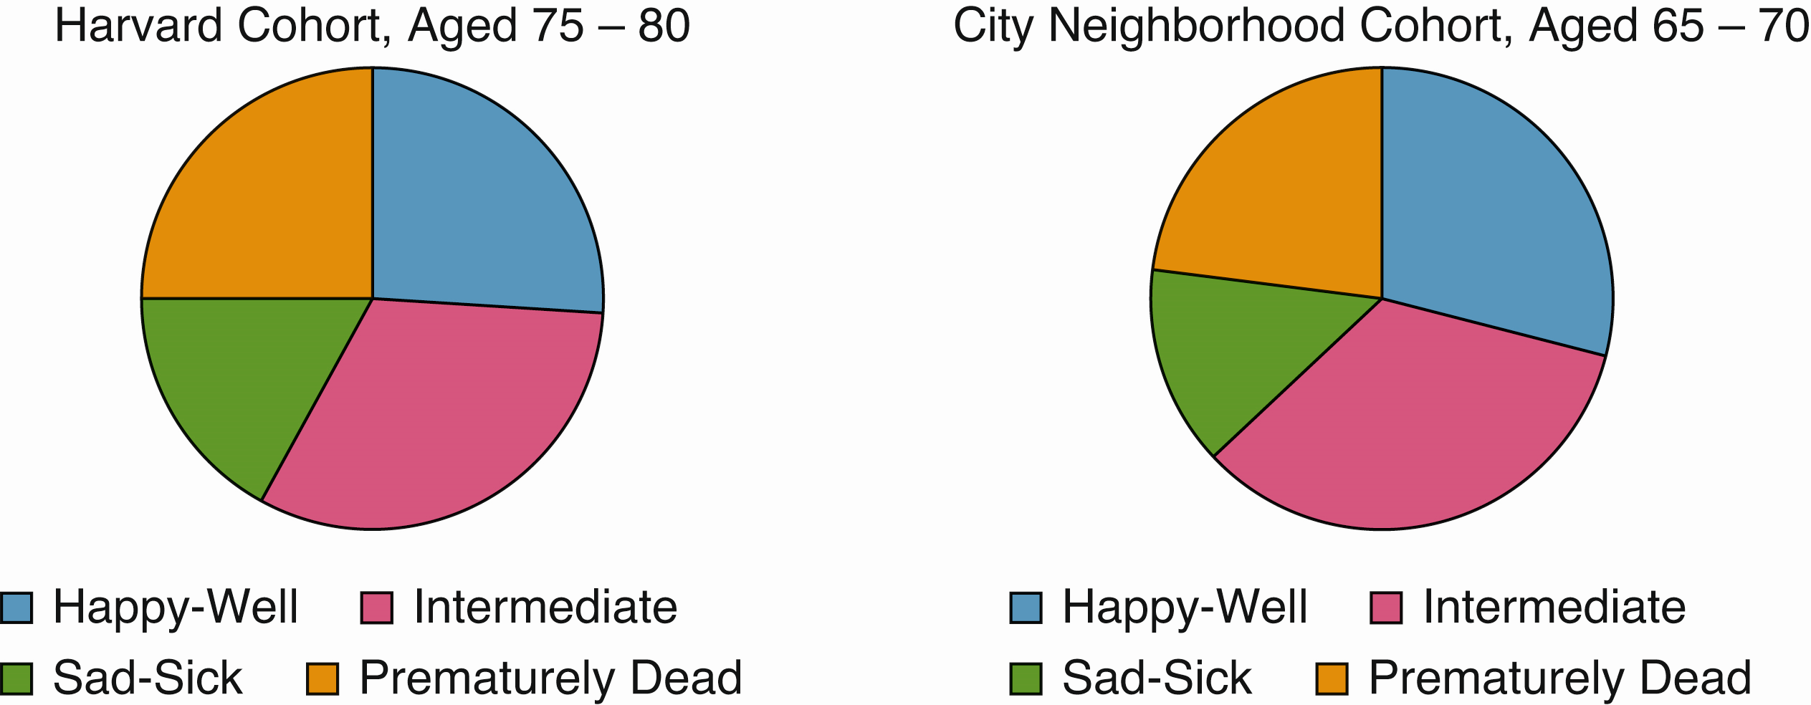
Harvard Study

Slide 21
Aspect | Harvard Study of Adult Development | MacArthur Study of Successful Aging
Start Date & Scope | Began in 1938; followed 724 men (and later their families) across decades. | 1980s–1990s; studied ~1,000 older adults (ages 70–79) across the U.S.
Main Focus | What makes for a happy, healthy life over the lifespan. | What factors lead to successful aging and functional independence.
Key Outcome | Good relationships are the strongest predictor of long-term well-being. | Lifestyle choices (not genetics) are the main driver of aging well.
Definition of Well-Being | Emotional fulfillment, physical health, life satisfaction, and secure attachment. | Low disease/disability, high cognitive and physical function, and active engagement.
Top Predictors of Health & Happiness | - Close, supportive relationships- Emotional intelligence- Secure attachment- Purpose and resilience | - Physical activity- Cognitive stimulation- Social engagement- Positive attitude and self-efficacy
Role of Genetics | Genetics play a role but are less important than relationships and behavior. | About 30% genetic, 70% determined by lifestyle and choices.
Mental Health Insights | Emotional well-being improves with age, especially when relationships are strong. | Cognitive decline is not inevitable; it can be slowed or avoided through lifestyle.
Social Connections | Loneliness is as harmful as smoking; quality of relationships matters most. | Social ties protect against mental and physical decline.
Notable Quote | “Good relationships keep us happier and healthier. Period.” – Dr. Robert Waldinger | “Aging is largely under individual control.” – Dr. John Rowe & Dr. Robert Kahn

Slide 22
Aspect | Harvard Study | MacArthur Study
Start and Scope | 1938; 724 men (then wives) | 1000 older adults 1980s-90s
Main Focus | What makes for a happy, healthy life over the lifespan | What factors lead to successful again and functional independence
Key Outcome | Good relationships are the strongest predictor of long-term well-being | Lifestyle choices (not genetics) are the main driver of aging well
Def of WB | Emotional fulfillment, physical health, life satis and secure attachment | Low disease/disability, high cognitive and physical function and cognitive engagement
Top Predictors of Health & Happiness | Close supportive relationships, emotional intelligence, secure attachment, purpose and resilience | Physical activity, cognitive stimulation, social engagement, positive attitude and self-efficacy
Social Connections | Quality of relationships matter most | Social ties protect against mental and physical decline

Slide 23
Journal Entry #19 Importance of Social Relationships
“Good relationships keep us happier and healthier. Period.” –Harvard Researcher
Create a Relationship Map
  In the center: write “Me”
  Around it, write the names of the 5–7 people you feel most connected to (family, friends, mentors, etc.)
Then, next to each name, write:
  How close or supported you feel (1–5 scale)
  How often you connect
  One word that describes the relationship (e.g., supportive, strained, joyful)
Reflect on relationships
Strengthen relationships

Slide 24
Journal Entry #19 Importance of Social Relationships
“Good relationships keep us happier and healthier. Period.” –Harvard Researcher
Reflect on relationships
  Which relationships feel most nourishing?
  Are there relationships may be in need of repair?
  Are there relationships you want to deepen?
Strengthen relationships
  Choose one relationship from your map
  What’s one small thing you can do this week to strengthen this connection?
  (e.g., send a message, plan a meet-up, say thank you)

Slide 25
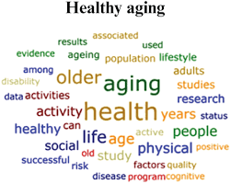
Processes of Successful Aging: Selection-Optimization-Compensation
Doing the best with what you have….looks at behavioral and psychological processes used to adapt to age-related losses (balance developmental losses with gains)

Slide 26
Processes of Successful Aging: Selection-Optimization-Compensation
Selection – focus on important goals in context of developmental stage
  Elective (choose to move to PT work to spend more time with grandkids)
  Loss-based (healthy condition limits what can do)
Optimization – strengthen skills already have (e.g., take course to learn how to use zoom so you can talk to grandkids)
Compensation – resources and aids to compensate for losses in order to adapt to changes and create environment for success
  Walk-in showers, readers, lighter pans, hire lawn care

Slide 27
SOC Related to:
Satisfaction with age
Positive emotions
Absence of loneliness
Focus on most important goals
AND
Moderates relationships between financial hardship and life satisfaction (relationship between financial hardship and life satisfaction is weaker at higher levels of SOC)

Slide 28
Socioemotional Selectivity Theory
Focusing on the right goals at the right time
As people age, goals tend to focus more on stability, maintenance, and regulation of emotions
Developmentally appropriate goals matched to perceptions of how much time one has left
Older adults tend to evidence positivity effect
Enhanced processing of positive emotional stimuli compared to negative emotional stimuli
Older adults tend to invest time and emotion into most important people in social networks

Slide 29
The Hispanic Paradox
Latinx Americans, especially those born outside of the US, tend to have equal or superior health outcomes despite worse socioeconomic indicators than White Americans
  Some evidence this is also true in terms of a psychological health advantage
    White older adults: living with their children associated with lower life satisfaction
    Latinx older adults: living with their children associated with higher life satisfaction
  Important to consider both nativity and nationality
  Some have suggested this finding may be a result of biased sample selection

Slide 30
Age and Well-Being
Paradox: older adults tend to be less physically healthy, but happier
Study from 160 countries
U-shaped association between age and emotional well-being
Mid-20s through 40s: well-being decreases
Age 45 – 54: lowest levels of well-being
Mid-50s through 80s: well-being increases
Stress has a similar (but opposite direction) trajectory
Most true for high-income, English-speaking countries

Slide 31

Age and Well-Being
Emotional maturity hypothesis
  With age comes better regulation of emotions
  Reappraisal, especially positive reappraisal of situations very helpful

Slide 32
Cultivating Resilience in Adults
APA: Factors for the cultivation of resilience
1. Make connections with family, friends, or community.
2. Avoid seeing crises as insurmountable problems.
3. Accept that change is part of living.
4. Move toward your goals.
5. Take decisive action, use problem- and task-focused coping.
6. Look for opportunities for self-discovery.
7. Nurture a positive view of yourself.
8. Keep events in perspective.
9. Maintain a hopeful outlook.
10. Take care of yourself, attend to your needs and feelings.
Notes:
Factors for the cultivation of resilience: Other factors that enhance resilience include task- or problem-focused coping, commitment to goals, humor, patience, optimism, faith, altruism, mindfulness and self-compassion therapy and the use of mature defense mechanisms.
The APA suggests the following factors are generally important for the cultivation of resilience:
1. Make connections with family, friends, or community.
2. Avoid seeing crises as insurmountable problems.
3. Accept that change is part of living.
4. Move toward your goals.
5. Take decisive action, use problem- and task-focused coping.
6. Look for opportunities for self-discovery.
7. Nurture a positive view of yourself.
8. Keep events in perspective.
9. Maintain a hopeful outlook.
10. Take care of yourself, attend to your needs and feelings.

Slide 33

Wisdom
Good judgment and advice in important but uncertain matters of life
Five skills that characterize wisdom (Staudinger & Baltes):
  Factual knowledge
  Strategic knowledge
  Consideration of life’s uncertainties
  Consideration of the contexts in which decisions are made and activities take place
  Consideration of values and life goals through a lens of relativism

